Slide 1
Python Tutorial
By Alok kumar Nayak

Slide 2
Precap
Python is a general purpose high level programming language.
Python was developed by Guido Van Rossam in 1989, while working at National Research Institute at Netherlands.
Officially Python was made available to public in 1991. The official Date of Birth for Python is : Feb 20th 1991.
Why the name ‘Python’?
Python as All Rounder
Features and limitation of Python.
Installation of Python, Vscode and First Python Program.

Slide 3
Step 1 : Download VSCode from official website of VSCode ie. code.visualstudio.com and Install it in Windows System
Install VS Code on Windows
First, navigate to the VS Code official website and download the VS code

Slide 4
Continued…
Second, launch the setup wizard and install VS Code.

Slide 5
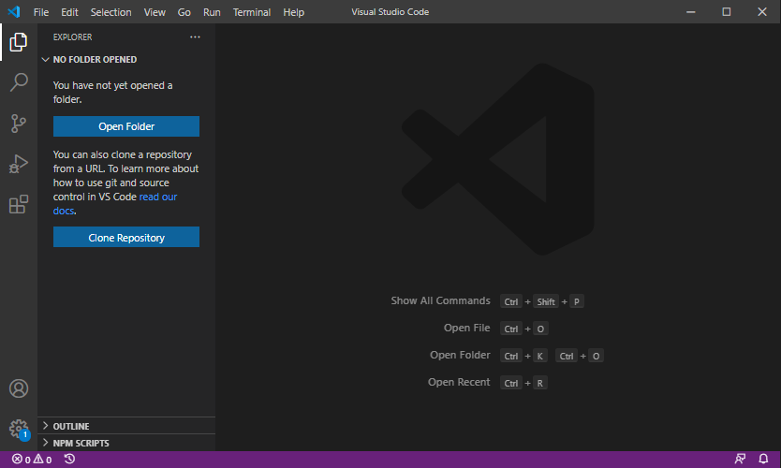
Step 2 : Installing Python Extension in VSCode

Slide 6
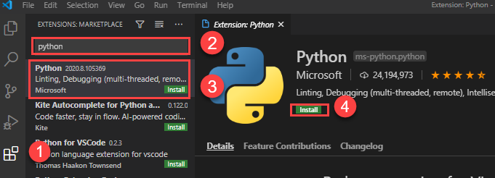
Continued..

Slide 7
Our First Program in VS Code
print('Hello, World!')
print() is a built-in function that displays a message on the screen.

Slide 8
Running the Python program
python 01.py
py 01.py

Slide 9
Python as calculator (IDE)
Python IDE is the Python Integration Development Environment (IDE)
This thing is called as REPL (Read Evolve Print under Loop) tool.
These tools are not standard editors for executing the Python programs. These are used to test small code only.

Slide 10
Input & Output :
input() :
input() function can be used to read data directly in our required format.
String as default return type of input() function.
print() :
print() function can be used to display output to the console for end user sake.

Slide 11
Different forms of print()
Form-1 : print() without any argument.
Form-2: print() function to print of string argument.
Form-3: print() with variable number of arguments.
Form-4: print() with 'sep' attribute.
Form-5: print() with 'end' attribute.
Form-6: print(object) statement.
Form-7: print(String, variable list).
Form-8: print(formatted string)
Form-9: print() with replacement operator { }.

Slide 12
Programs
Addition of two numbers taking input from user.
Write a program to read Student data from the keyboard and print that data.
Write a program to read 3 numbers from the keyboard and print them with , separator and also print their sum.

